Slide 1
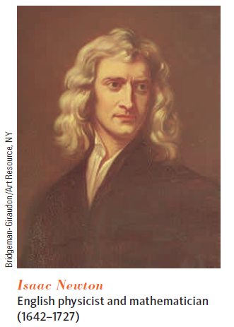
The Laws of Motion
The description of an object in motion included its position, velocity, and acceleration (kinematics). There was no consideration of what might influence the motion.
The area of such kind of studies is called Dynamics (a branch of mechanics that deals with forces and their relation primarily to the motion but sometimes also to the equilibrium of bodies-Merriam-Webster dictionary)
It comes to the famous three Newton’s laws of motion.
Newton’s law | Statement
1st | In the absence of external forces, an object at rest remains at rest and an object in motion continues in motion with a constant velocity
2nd | F = ma
3rd | Action & reaction
Introduction

Slide 2
Newton’s First Law
In the absence of external forces, AND when viewed from an inertial reference frame, an object at rest remains at rest and an object in motion continues in motion with a constant velocity.
Newton’s First Law describes what happens in the absence of a force (constant velocity => no acceleration).
The First Law also allows the definition of force as that which causes a change in the motion of an object.

Slide 3
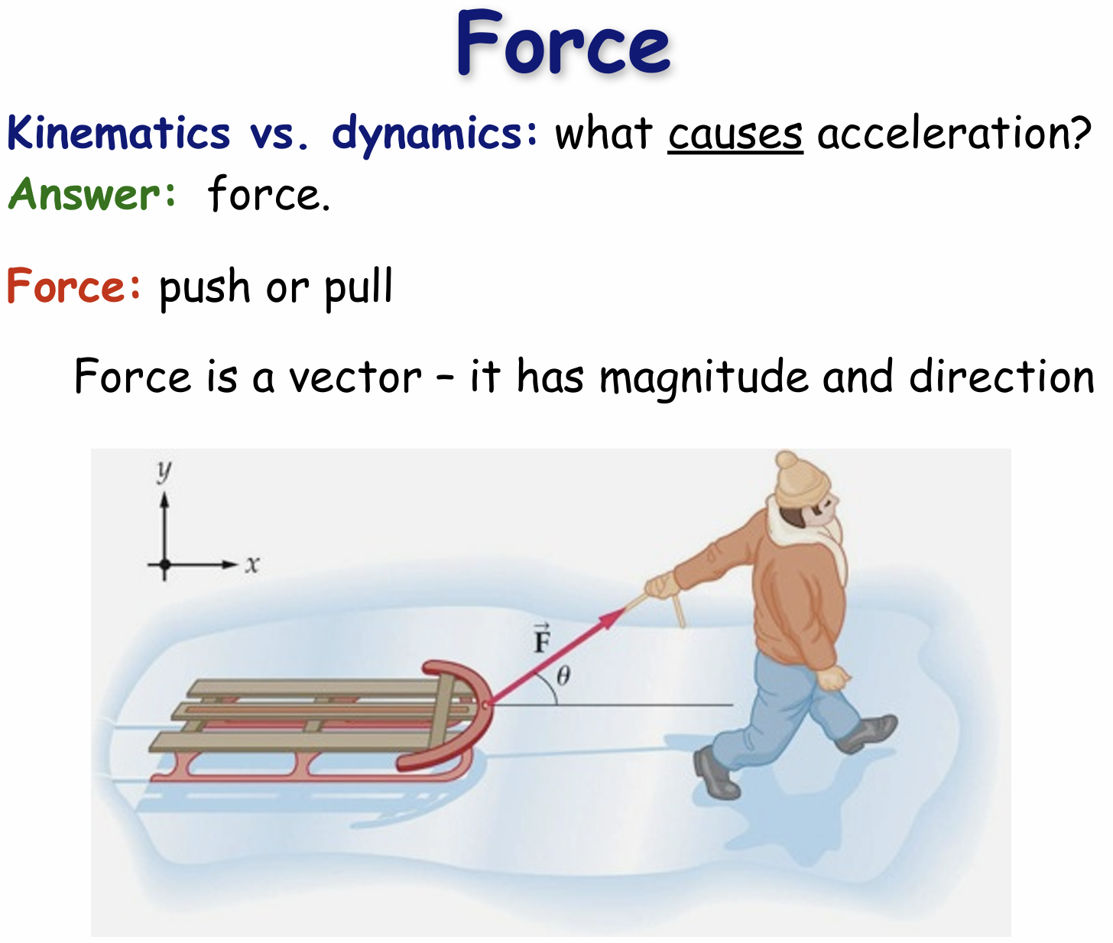

Slide 4
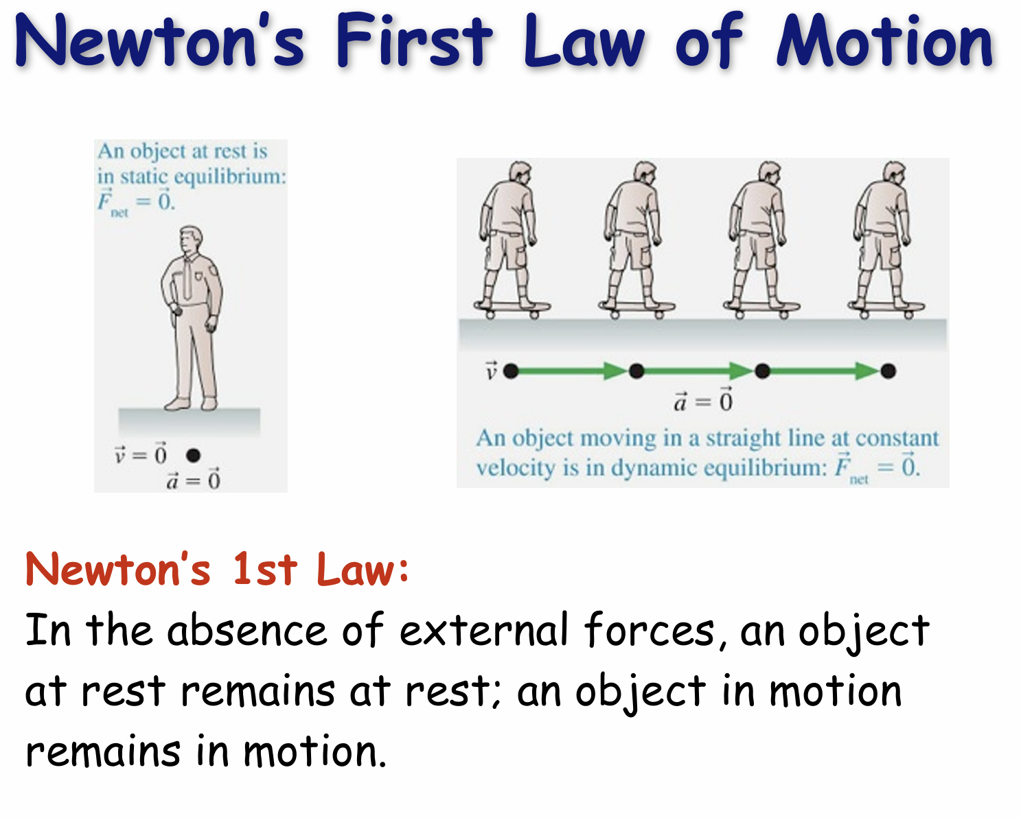

Slide 5
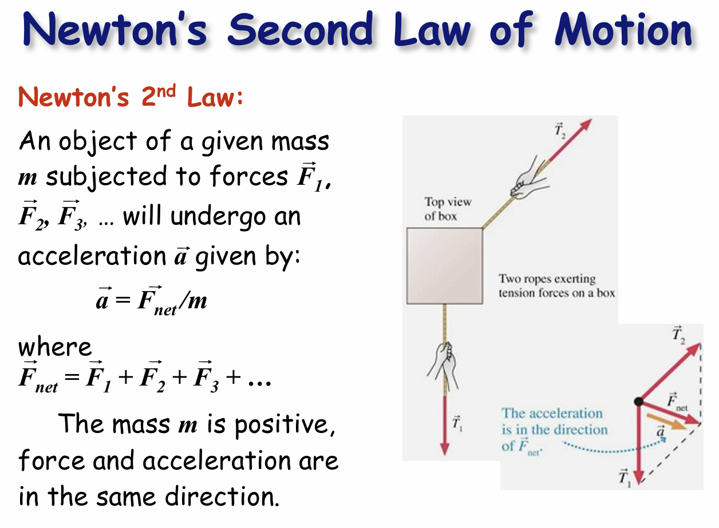

Slide 6
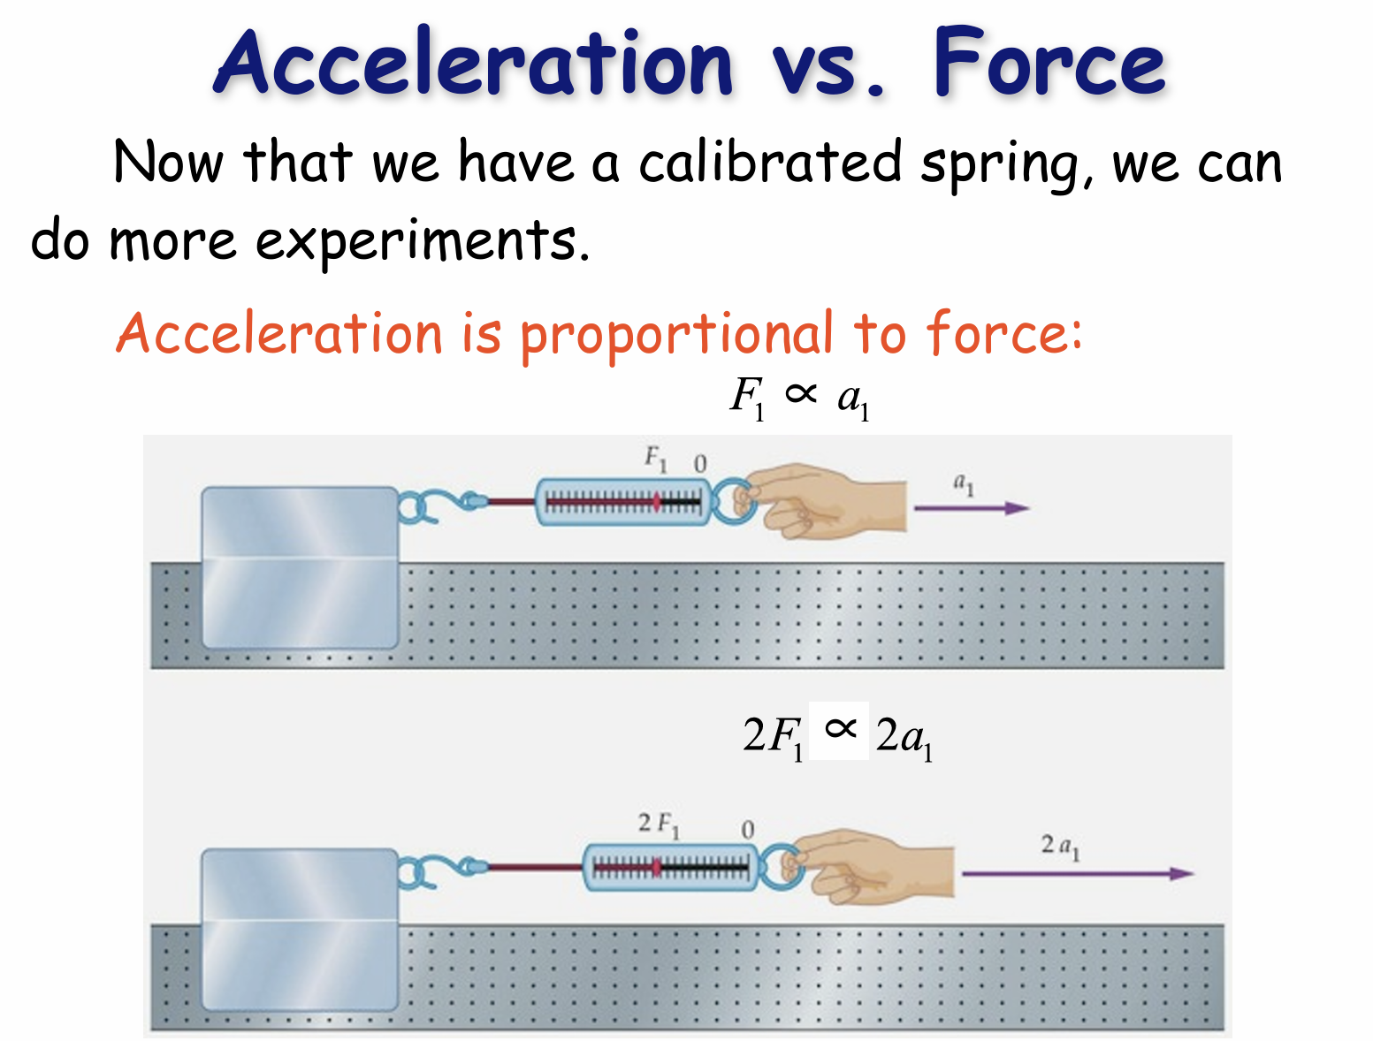

Slide 7
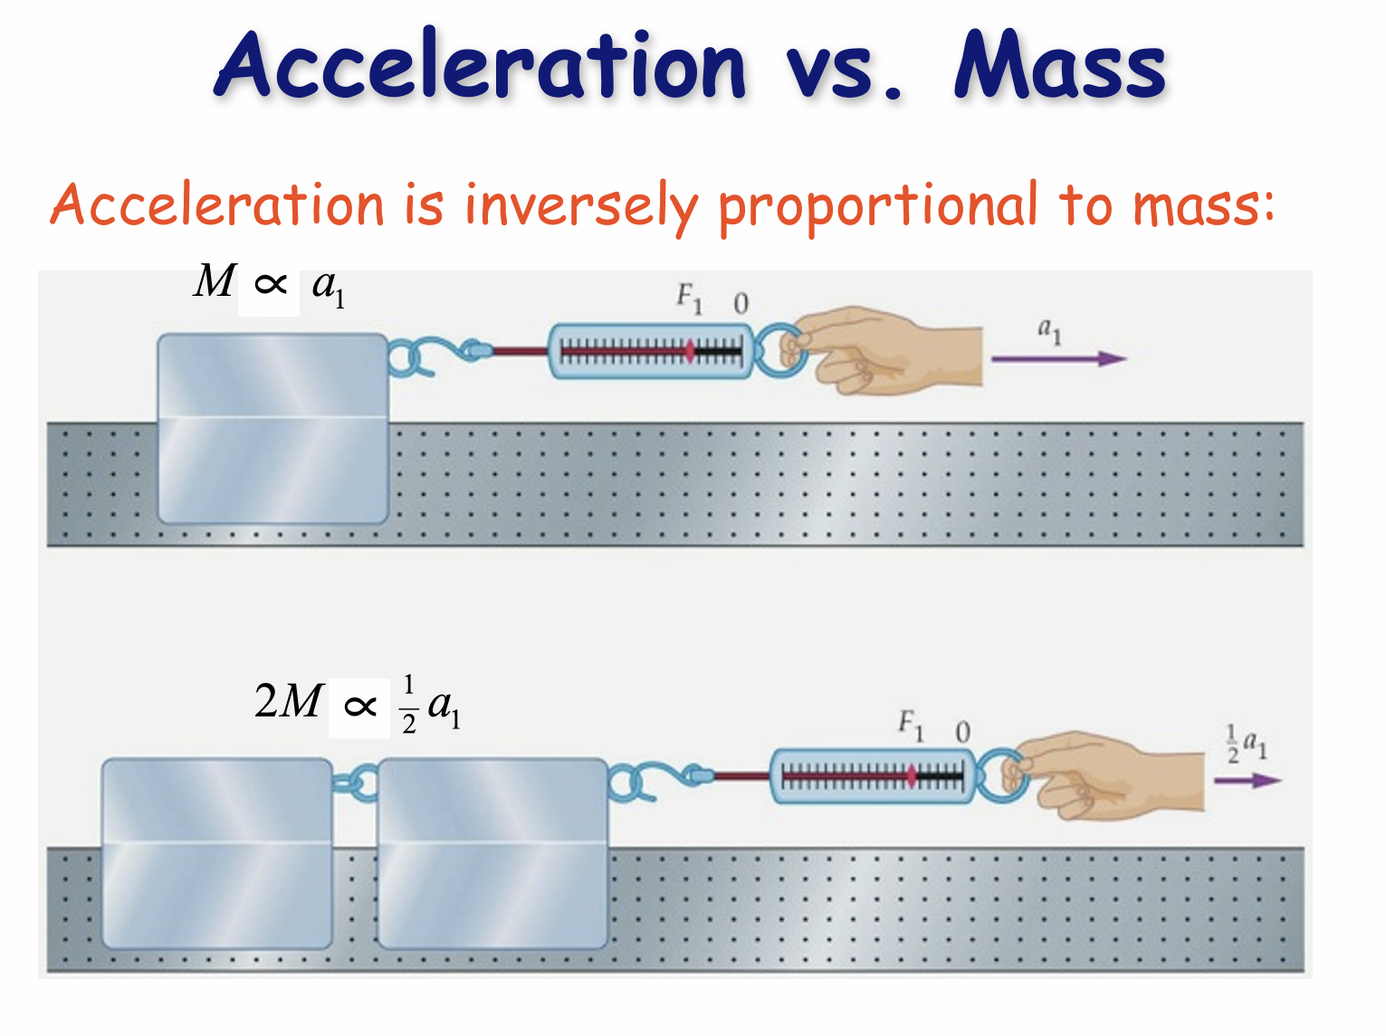

Slide 8
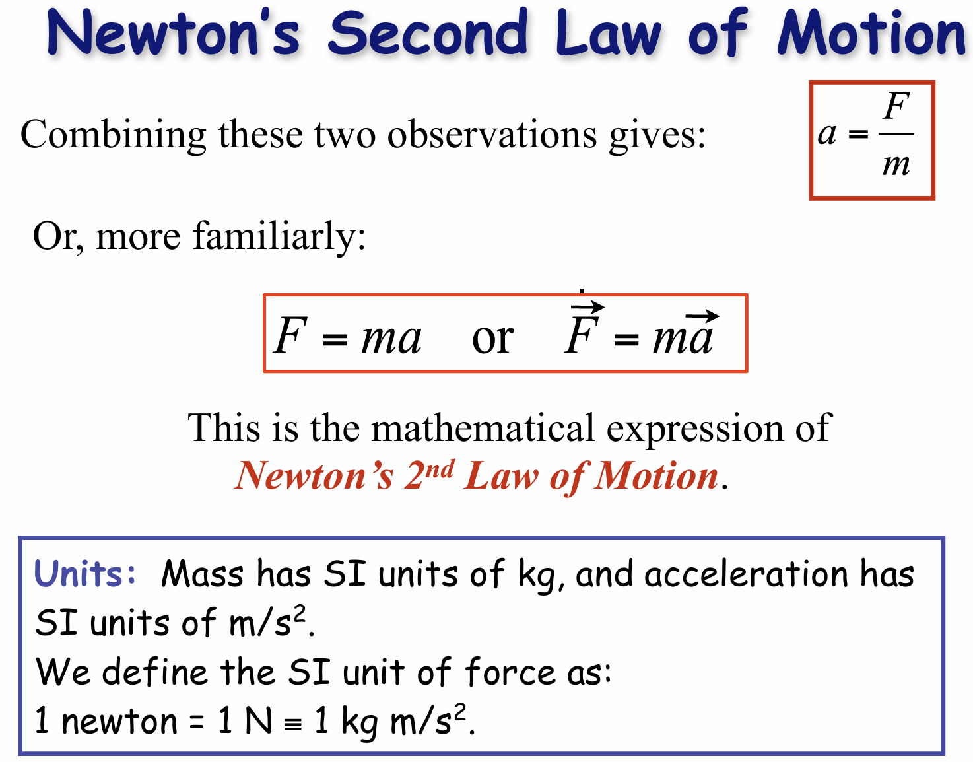

Slide 9
Inertia and Mass
The tendency of an object to resist any attempt to change its velocity is called inertia.
Mass is that property of an object that specifies how much resistance an object exhibits to changes in its velocity.
Masses can be defined in terms of the accelerations produced by a given force acting on them:
The magnitude of the acceleration acting on an object is inversely proportional to its mass.

Slide 10
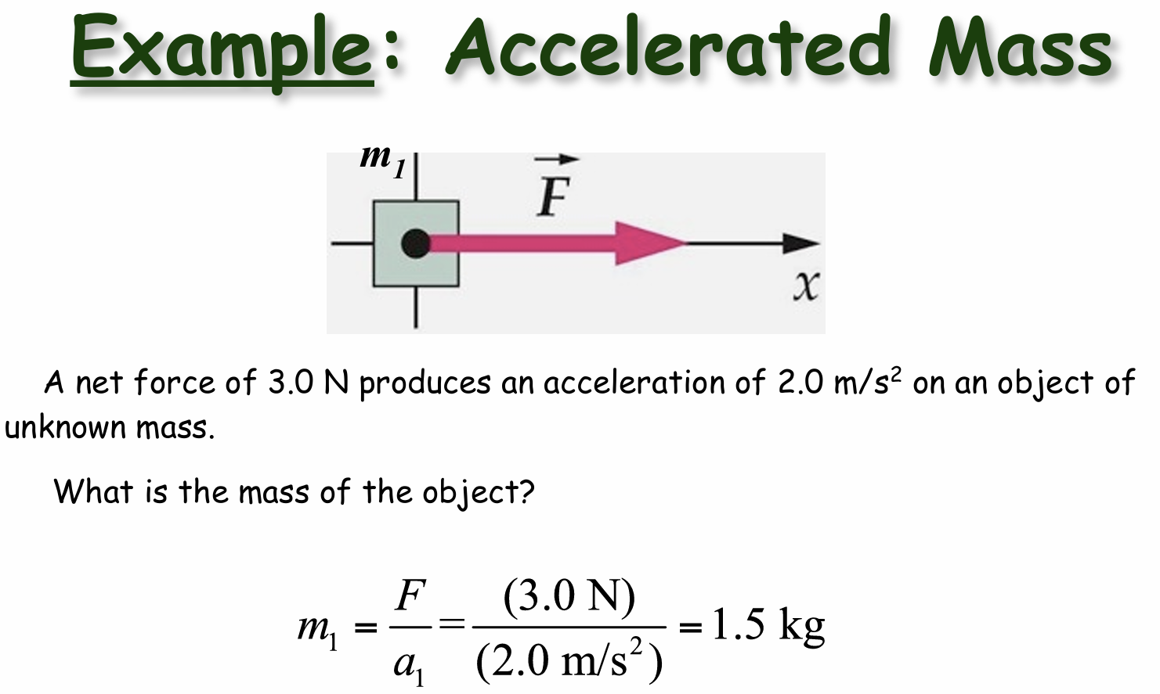

Slide 11
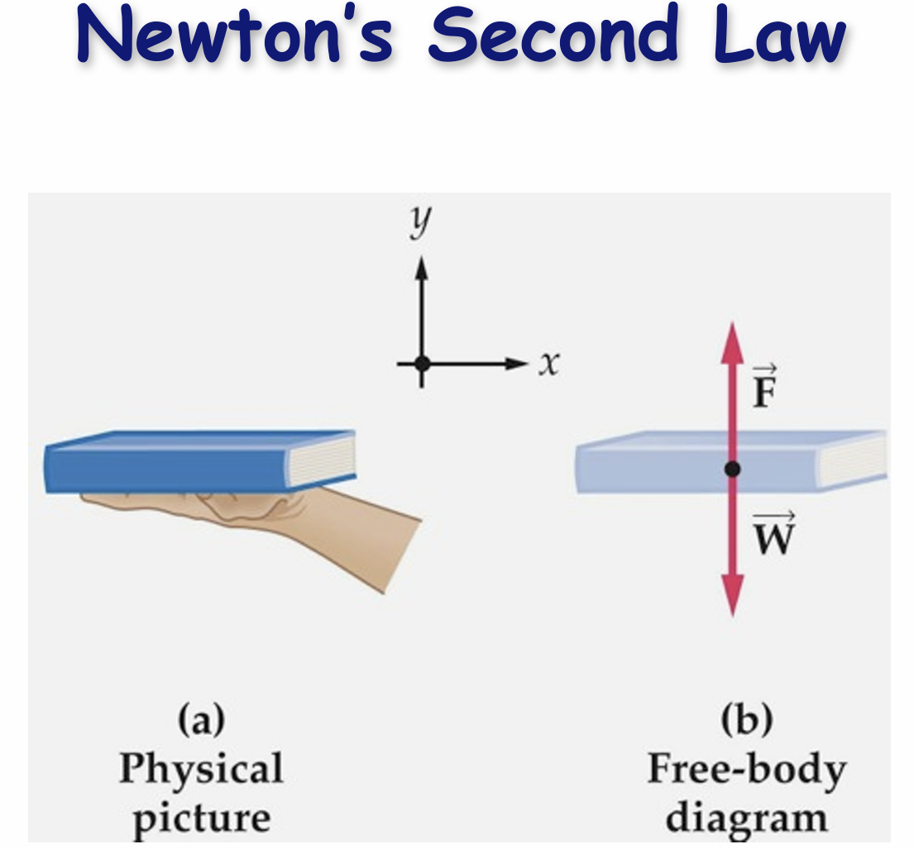

Slide 12


Slide 13
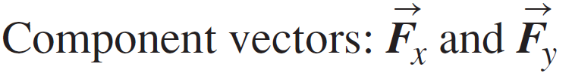
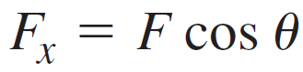
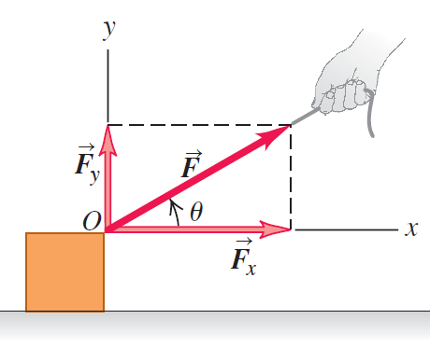
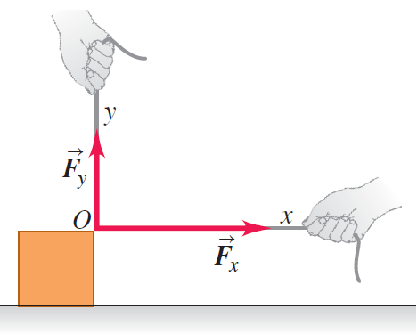
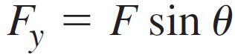
Superposition of Forces
Notes:
Will show by example.

Slide 14
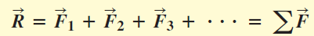
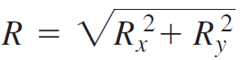
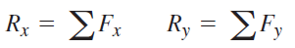
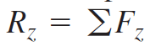
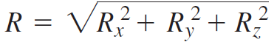
Superposition of Forces
Resultant force: sum of multiple forces
Symbol for sum
Net Force
2D space: magnitude calculation
Resultant force: also consists of x and y components
3D space:
Notes:
Resultant force does not have to include all the Forces on an object, so it is not always the same as the net force on the object.
Recall what we learn about vectors in kinematics, the magnitude of a vector is the ….
Will show by example.

Slide 15
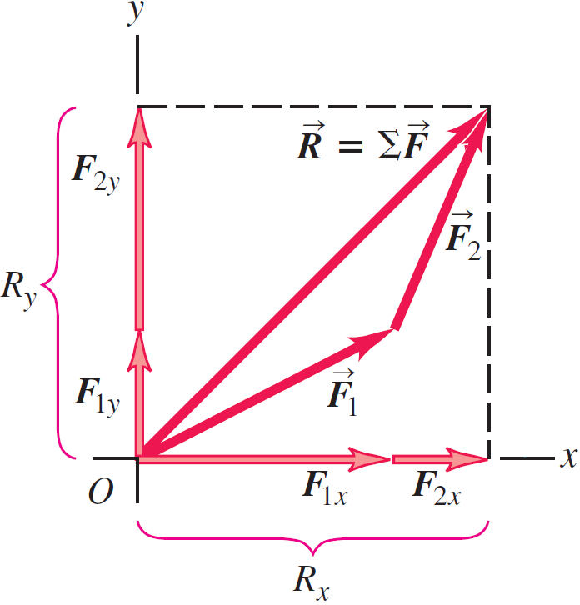
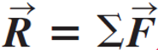
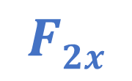
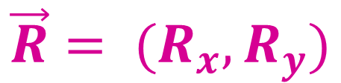
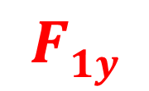

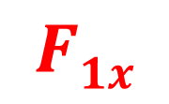
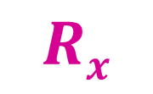
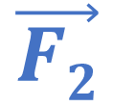
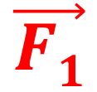
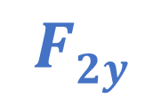
Example for Superposition
y
$Ry$
$F2y$
$\vec{F2}$
$F1y$
$\vec{F1}$
$F1x$
$F2x$
x
$Rx$
$$\vec{R}= {(R}_{x}, R_{y})$$
Notes:
Okay, let use this example to Understand the super-position. We will do this by analyzing this figure. (Vote: this figure is a mess! How should I read it!? I already know this, it is way too easy!)
Okay, let’s decompose this diagram. It might be complicated for some of you at the first look but essentially it is trying to show how we calculate the sum of two forces, F1, and F2. For clarity, I will use a different color to show them
After having these two forces here, and their x and y components. So what is the net force? From the vector math, we know that the sum of F1 and F2 can be obtained by connecting them head to tail. But if you decompose it to x and y, you will discover that Rx is the … Ry…..
The implication here is that
Okay, so the superposition law states that

Slide 16
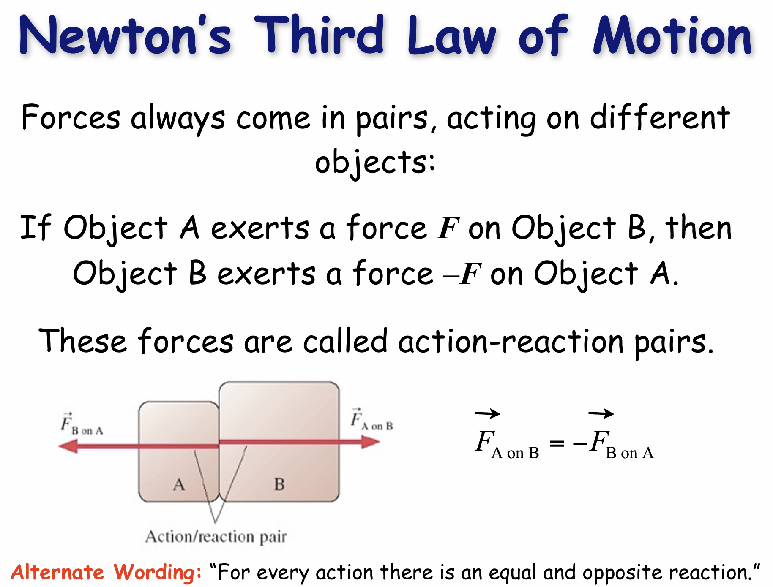

Slide 17
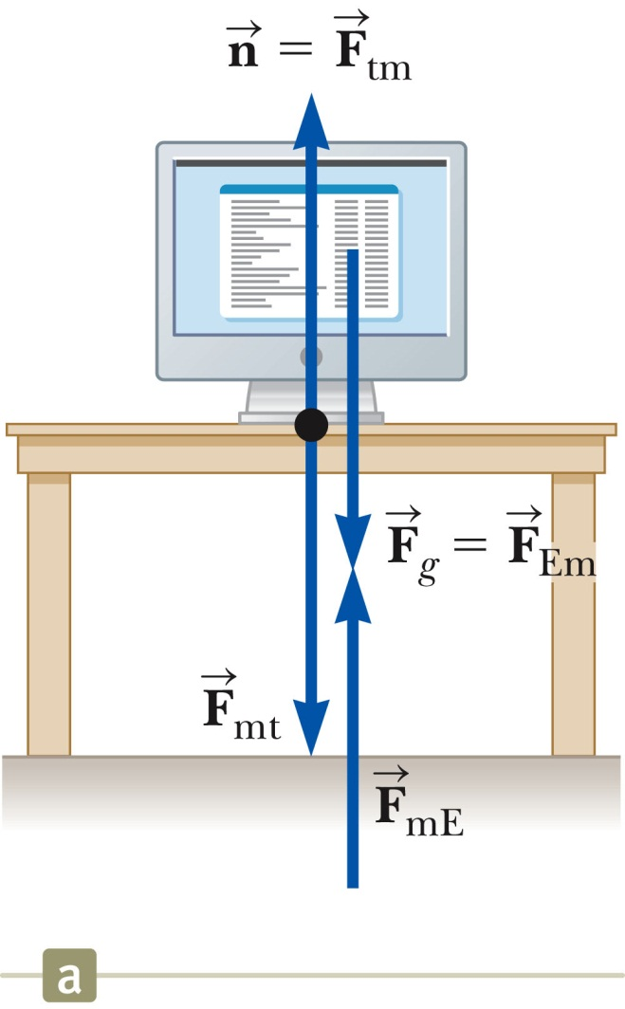
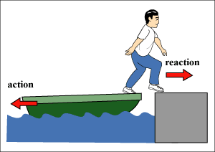
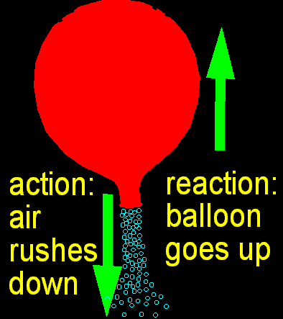
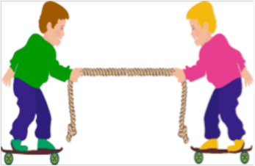
Action-Reaction pairs?

Slide 18
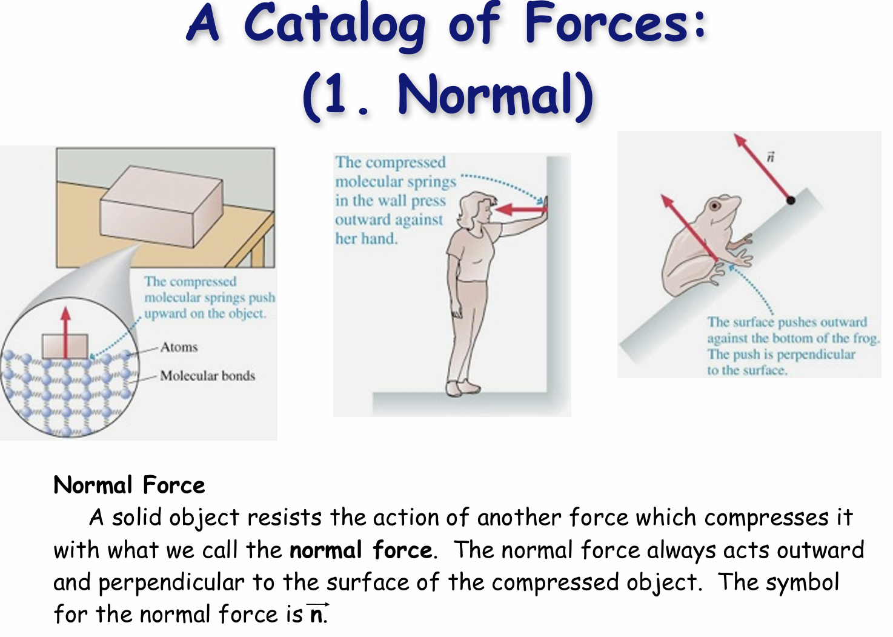

Slide 19
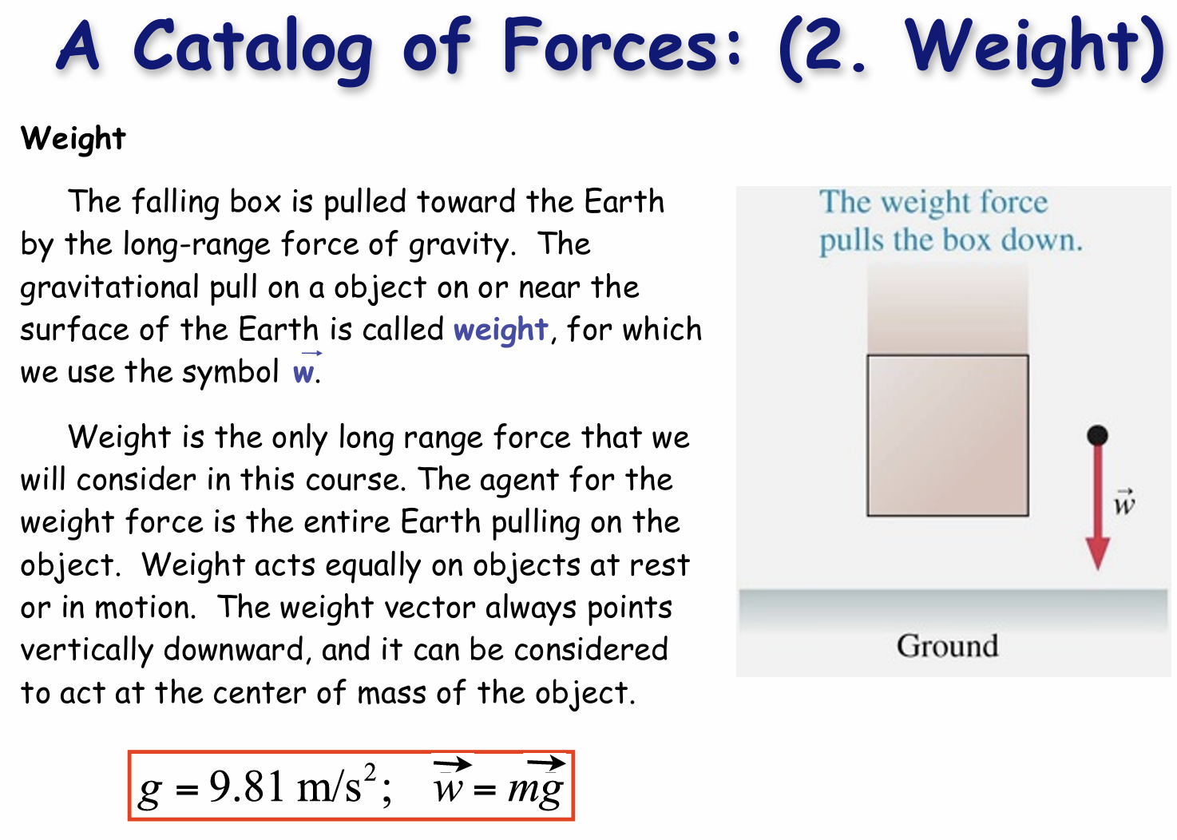

Slide 20
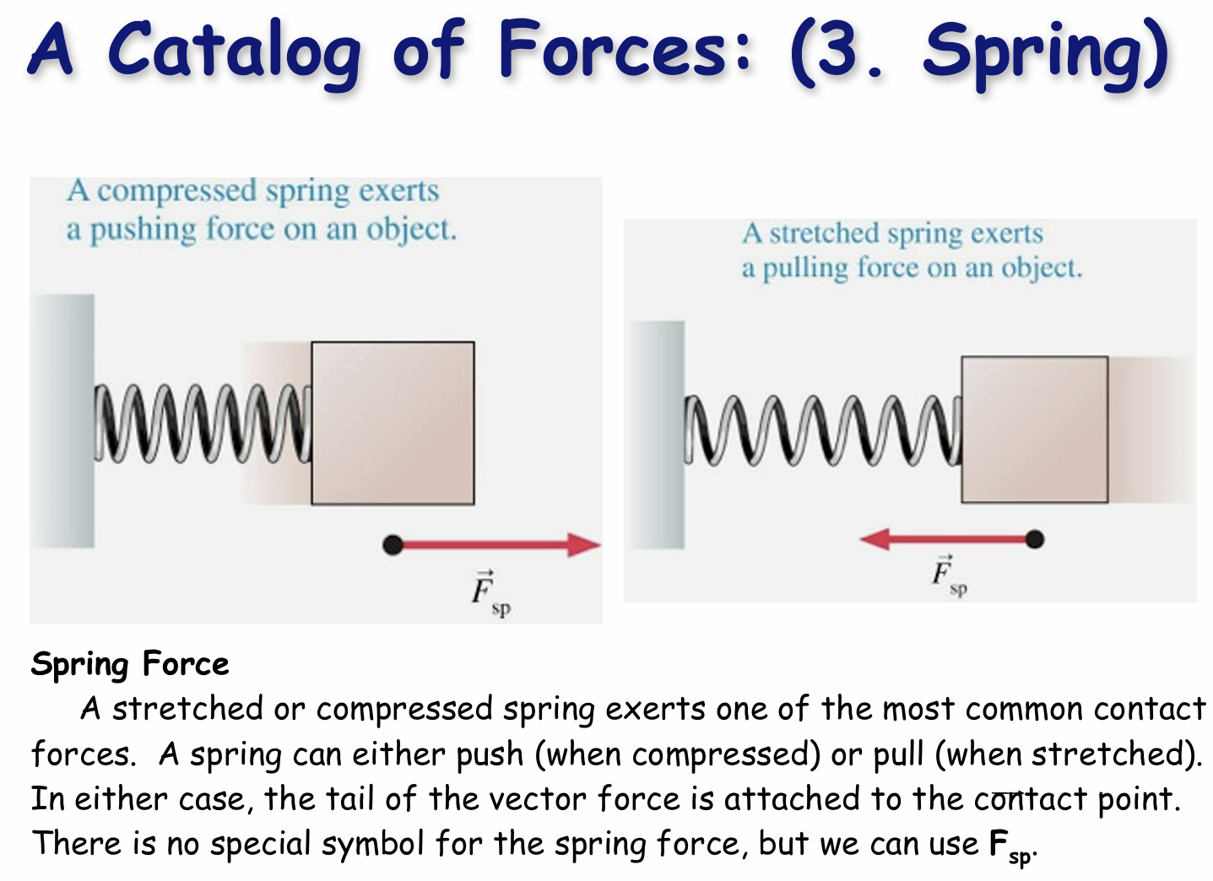

Slide 21
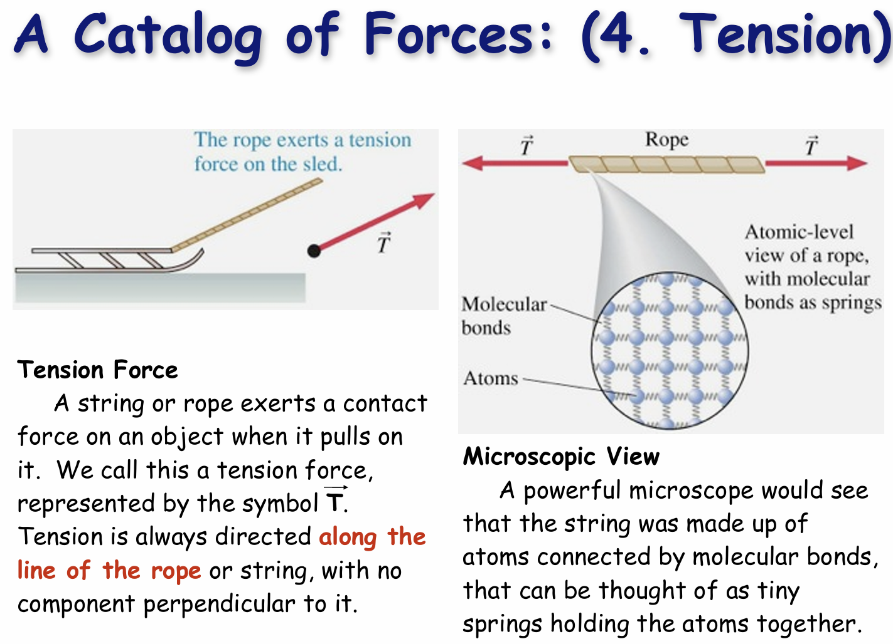

Slide 22
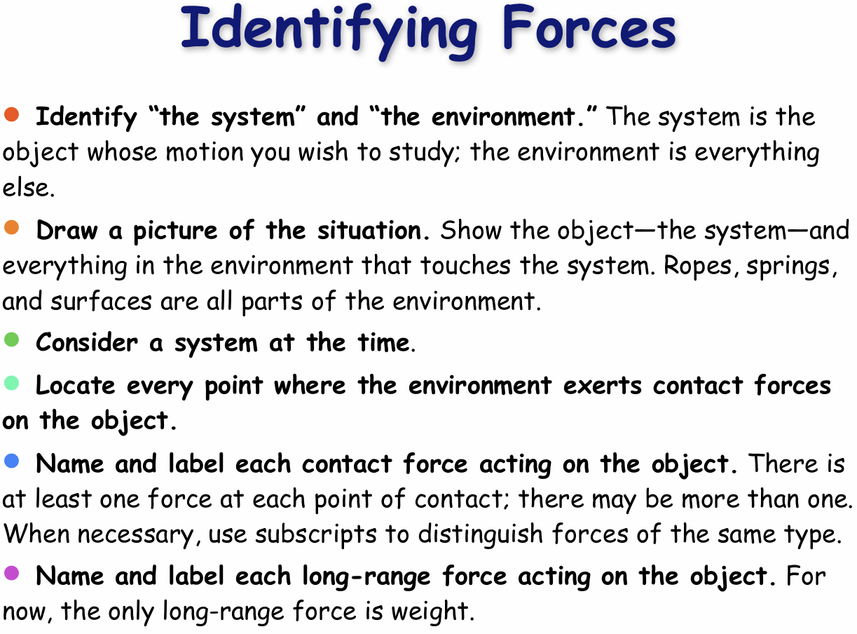

Slide 23
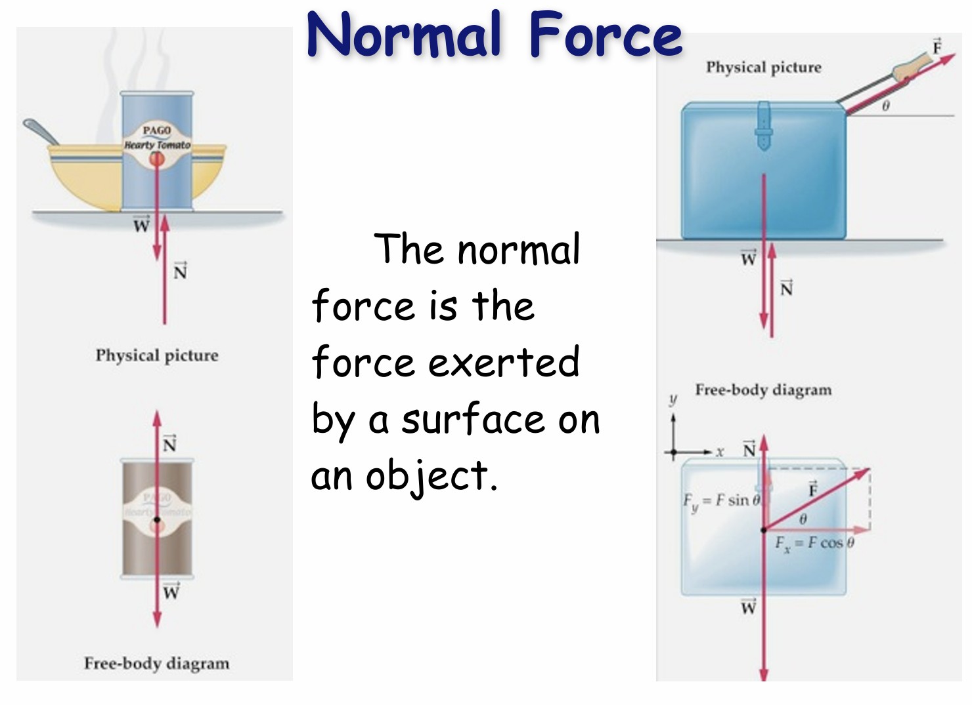

Slide 24
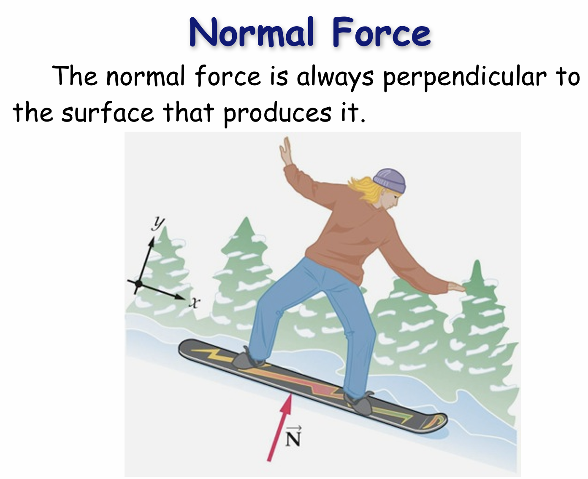

Slide 25
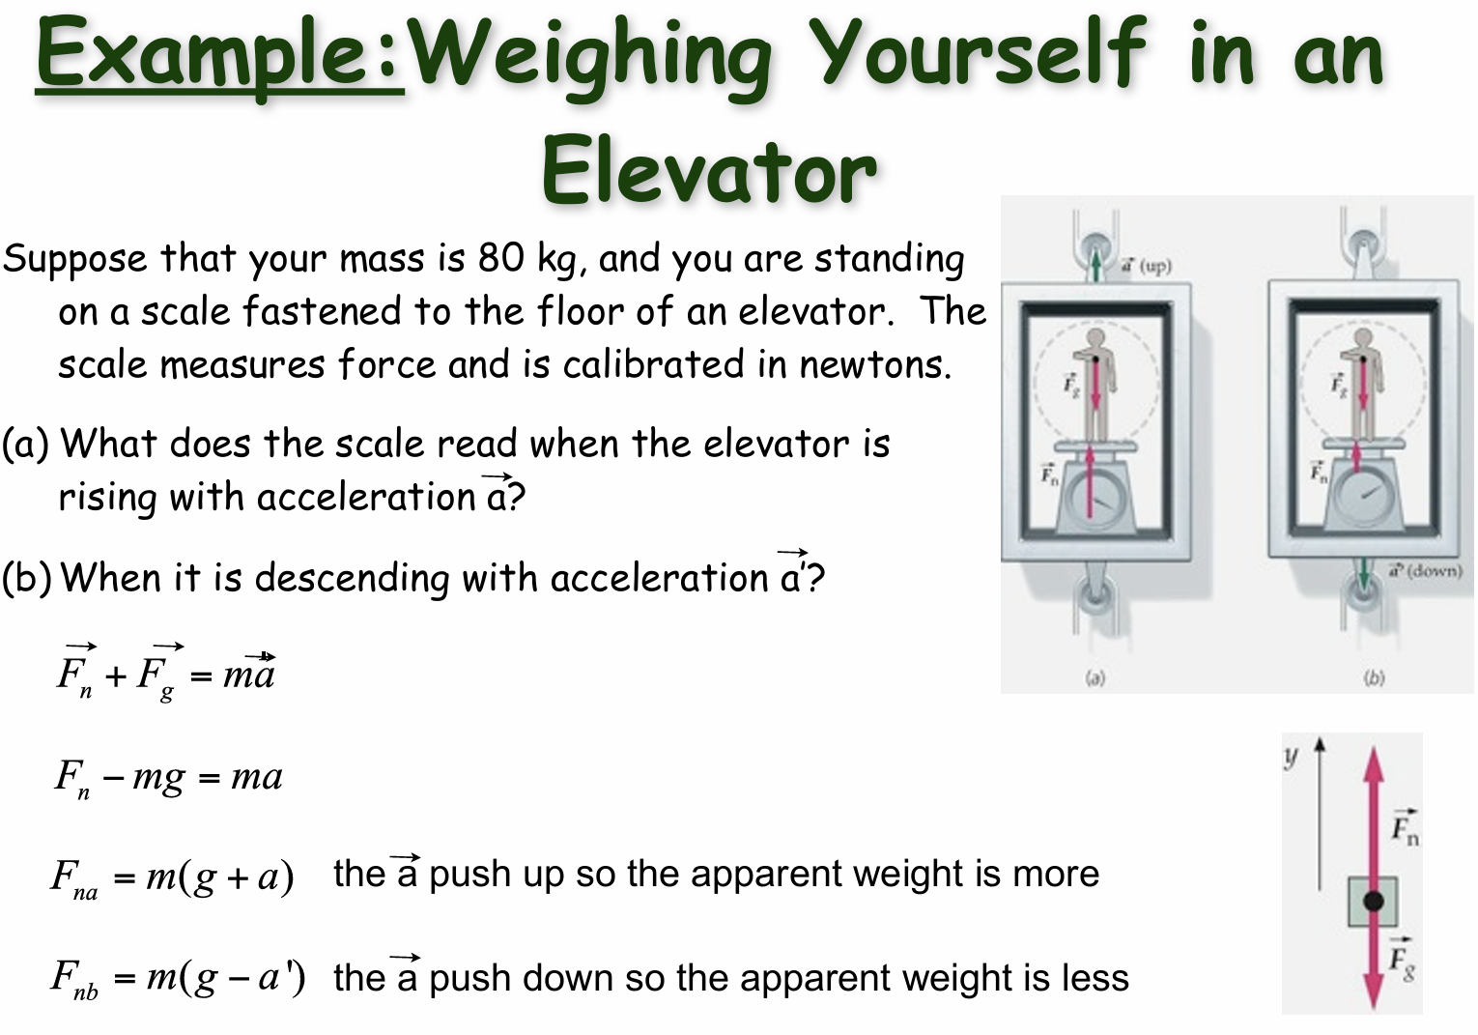

Slide 26
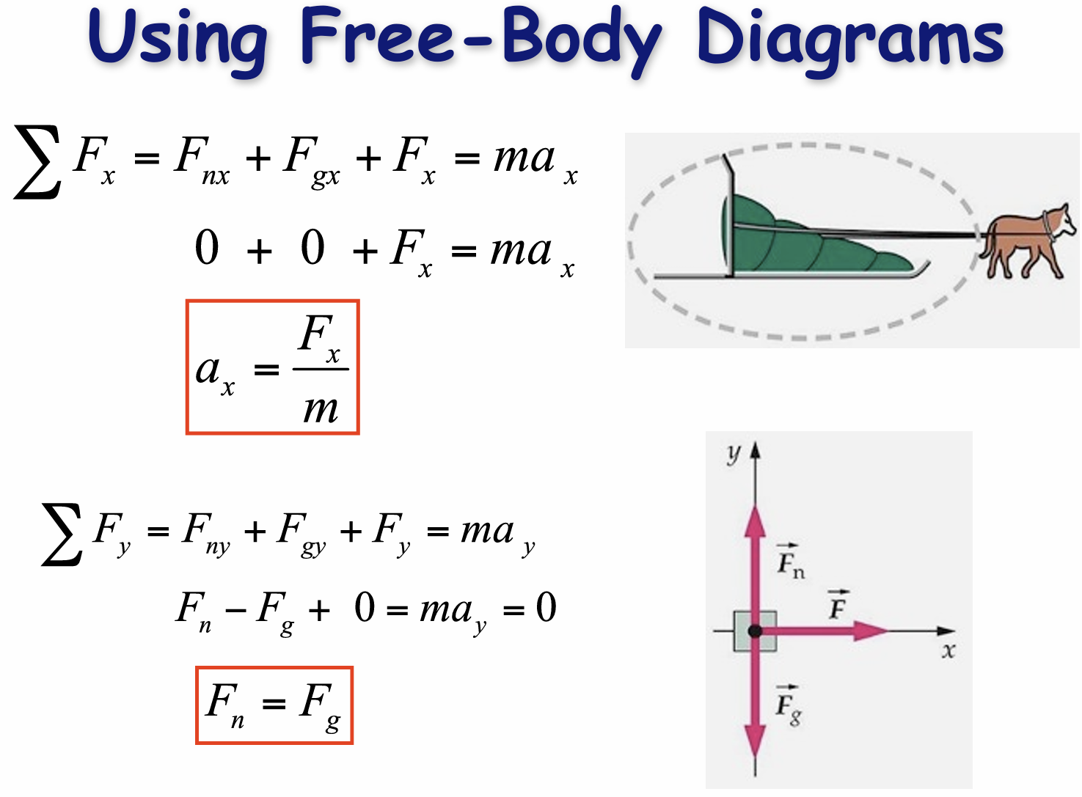

Slide 27
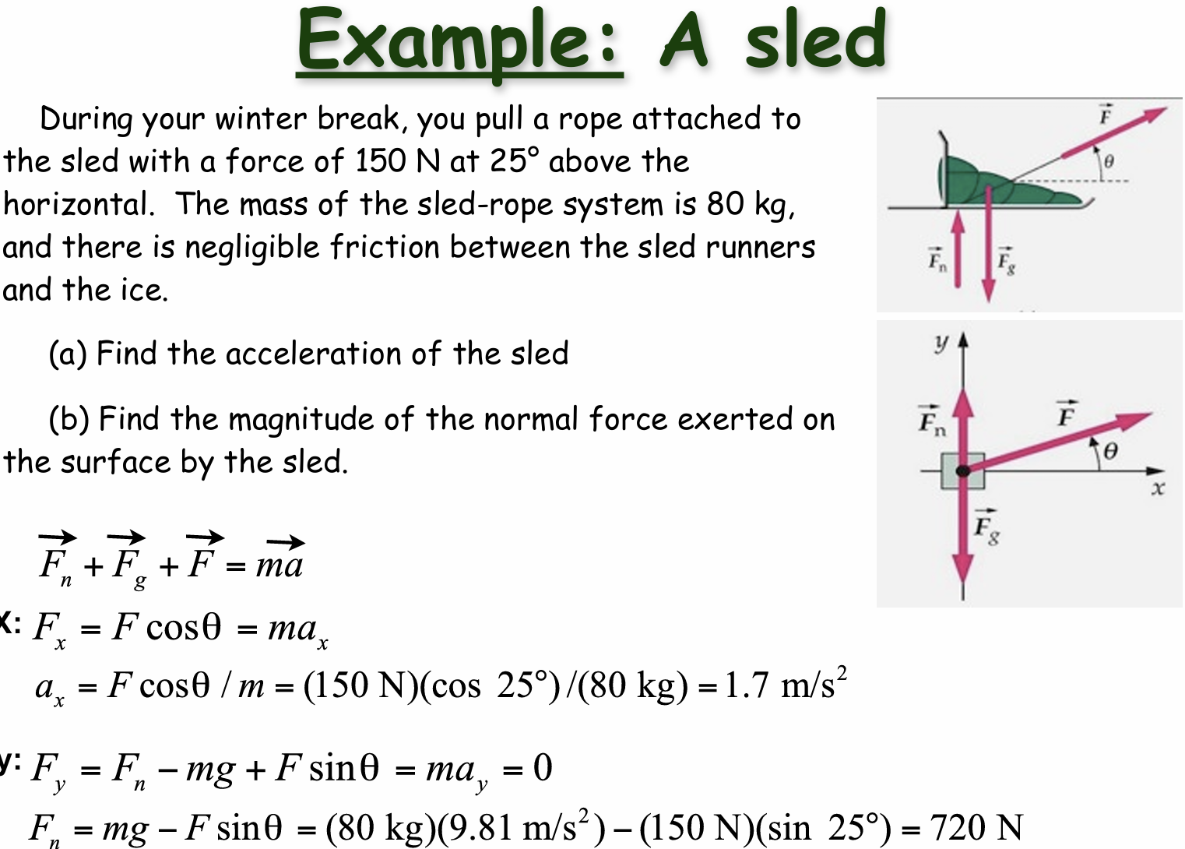

Slide 28
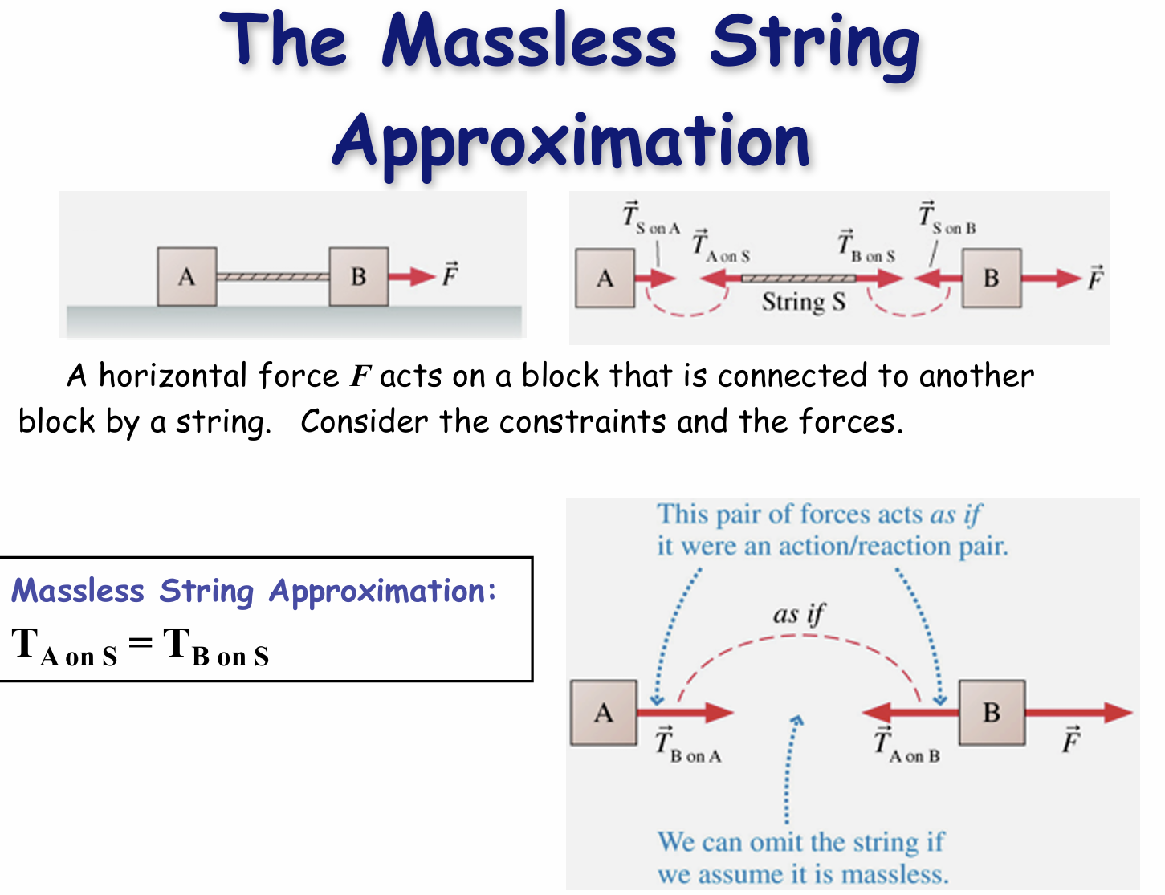

Slide 29
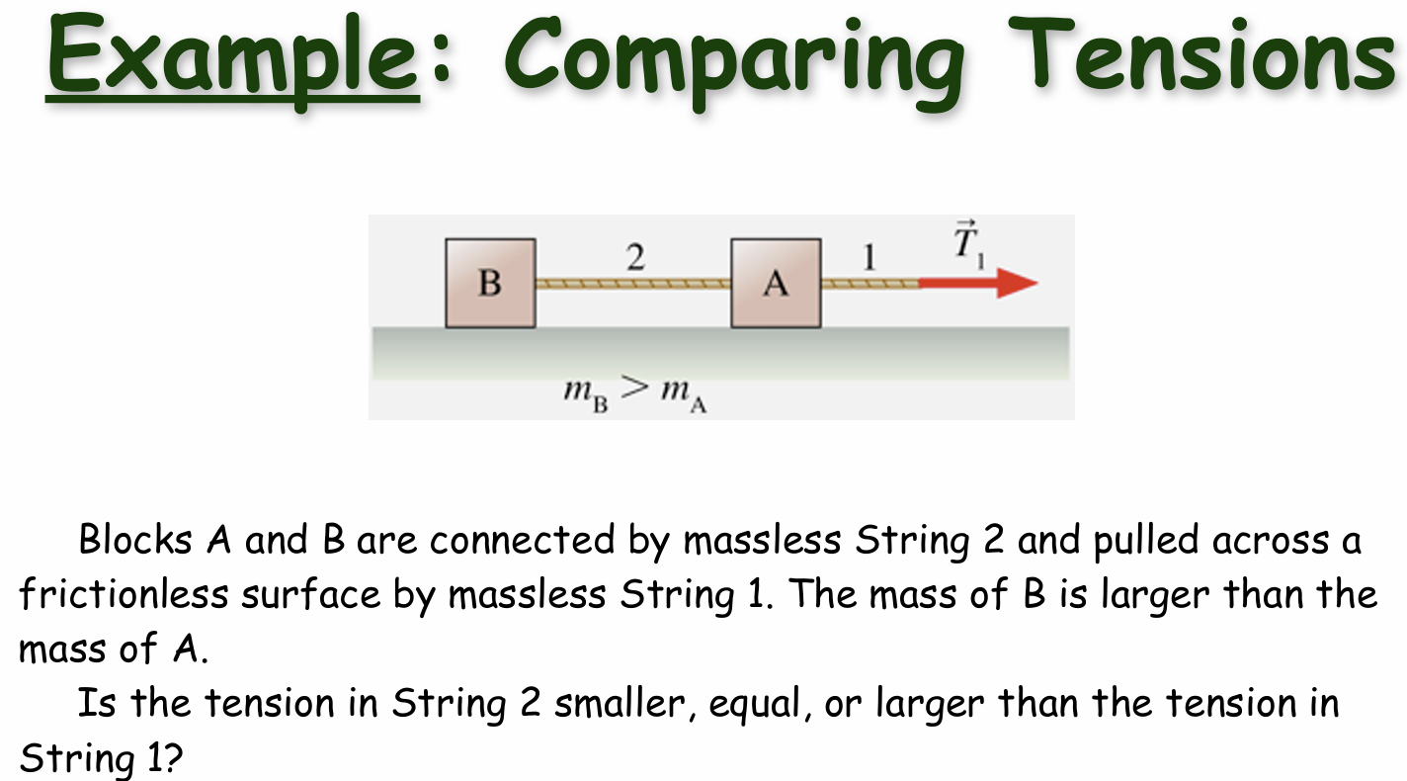

Slide 30
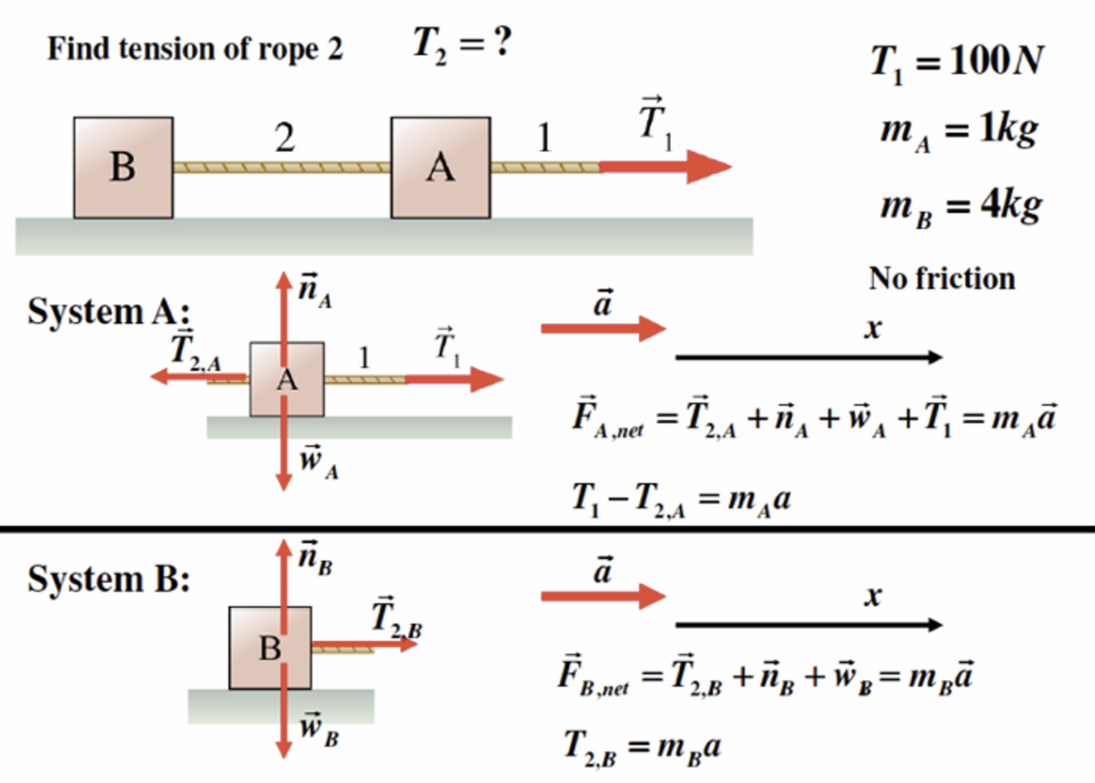

Slide 31
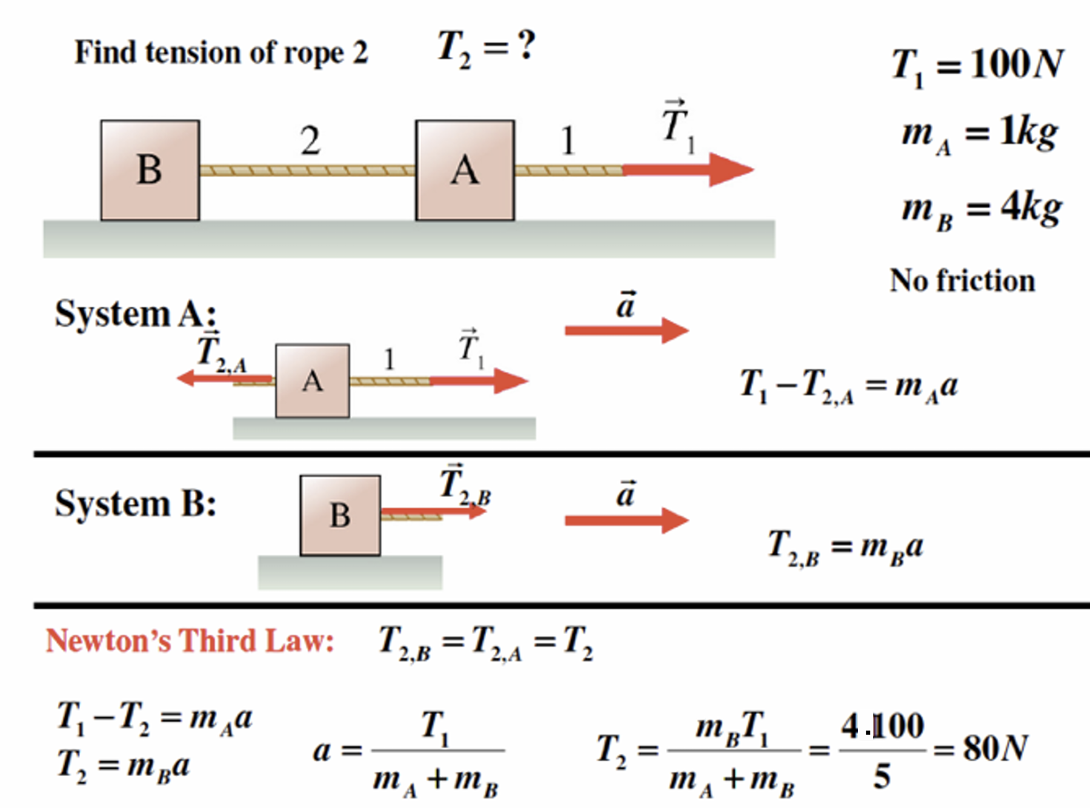

Slide 32
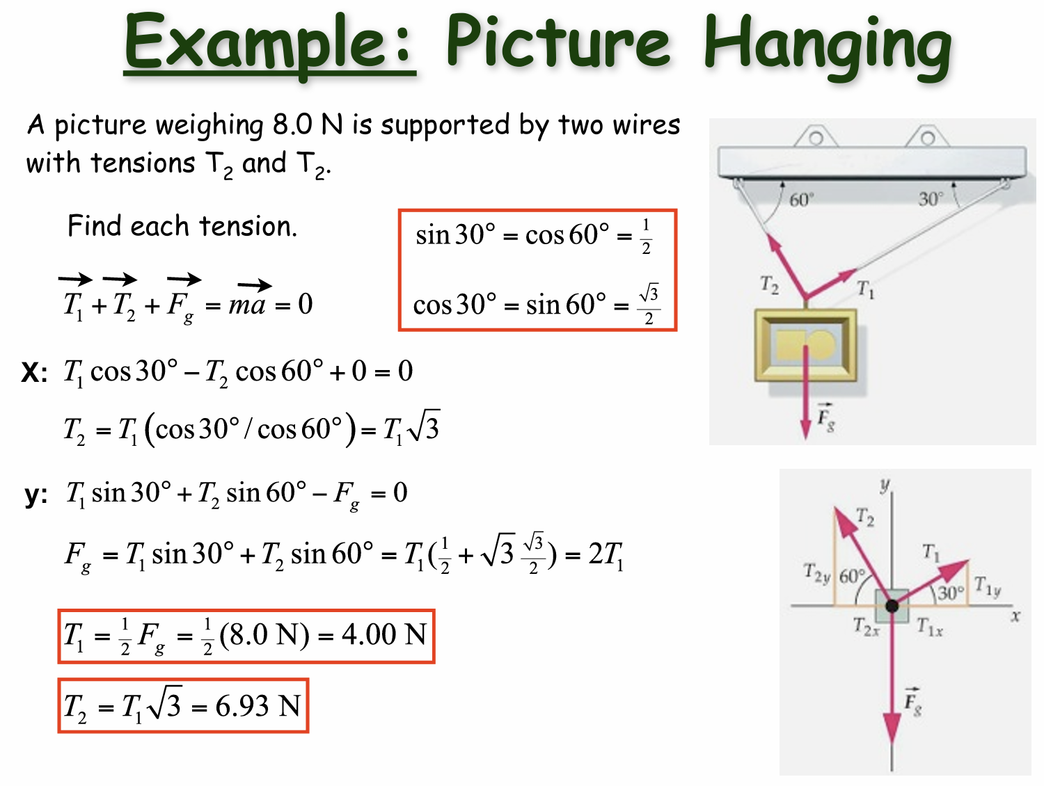

Slide 33
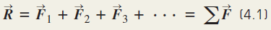








Summary
Notes:
Okay, I know we don’t usually like reading long text. Let’s try some examples!

Slide 34

Applying Newton’s 2nd law:
A man pulls a cargo box of mass 20 kg with an acceleration of 2 ms⁻² on a smooth surface. Find the tension of the rope and the normal force acting on the cargo box.
Draw the free body diagram.
Let rightwards and upwards be positive in x- and y-directions respectively.
For x-direction,
For y-direction,

Slide 35






Objects under net force

Slide 36












Slide 37




Slide 38



Slide 39
Weightless!

Slide 40



Multiple Objects

Slide 41










Slide 42
Forces of Friction
When an object is in motion on a surface or through a viscous medium, there will be a resistance to the motion. This resistance is called the force of friction.
Experiments show that friction is proportional to the normal force, is opposite the direction of motion and parallel to the surfaces in contact.
ƒ_{s} ≤ µ_{s} n and ƒ_{k}= µ_{k} n
μ is the coefficient of friction; n is the normal force
These equations relate the magnitudes of the forces; they are not vector equations.

Slide 43

Static Friction
Static friction acts to keep the object from moving.
As long as the object is not moving, ƒ_{s} = F
If increases, so does
If decreases, so does
ƒ_{s} ≤ µ_{s} n
Remember, the equality holds when the surfaces are on the verge of slipping.

Slide 44


Kinetic Friction
The force of kinetic friction acts when the object is in motion.
Although µ_{k} can vary with speed, we shall neglect any such variations.
ƒ_{k} = µ_{k} n

Slide 45

Some Coefficients of Friction
Section 5.8

Slide 46




Think about it!

Slide 47






Slide 48





Slide 49






Section 5.8

Slide 50


Slide 51


Slide 52


Slide 53


Slide 54


Slide 55


Slide 56


Slide 57


Slide 58


Slide 59




Laws of Motion

